Slide 1

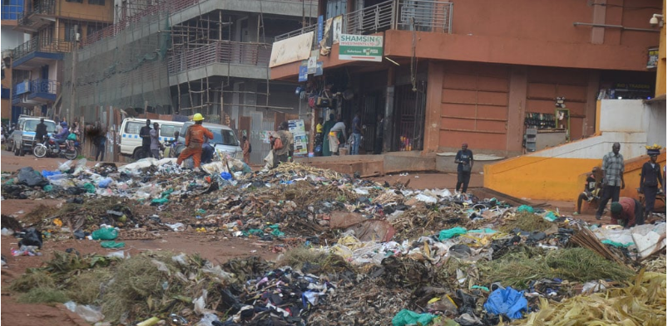
Clean Environment, Clean Water
A Disease Free Community
Alliance Water Solutions (AWASO)
Pitch Deck 2025

Slide 2

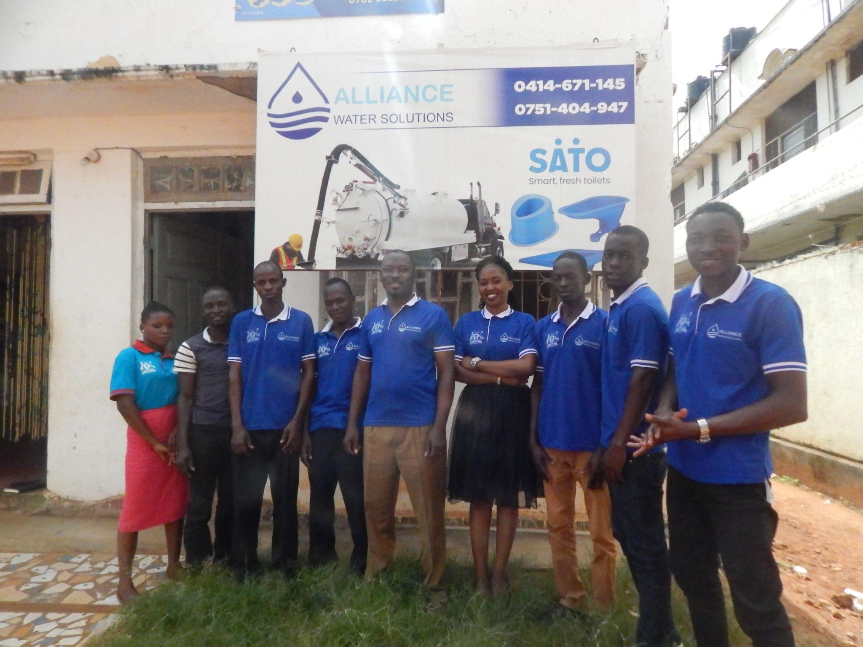

Who We Are
A Local WASH Company, Founded In 2014 And Legally Registered With The Government Of Uganda In 2018
Operates in Northern, Central and Eastern Uganda with offices in Jinja City.
Vision: Clean Environment, Clean Water A Disease Free Community

Slide 3
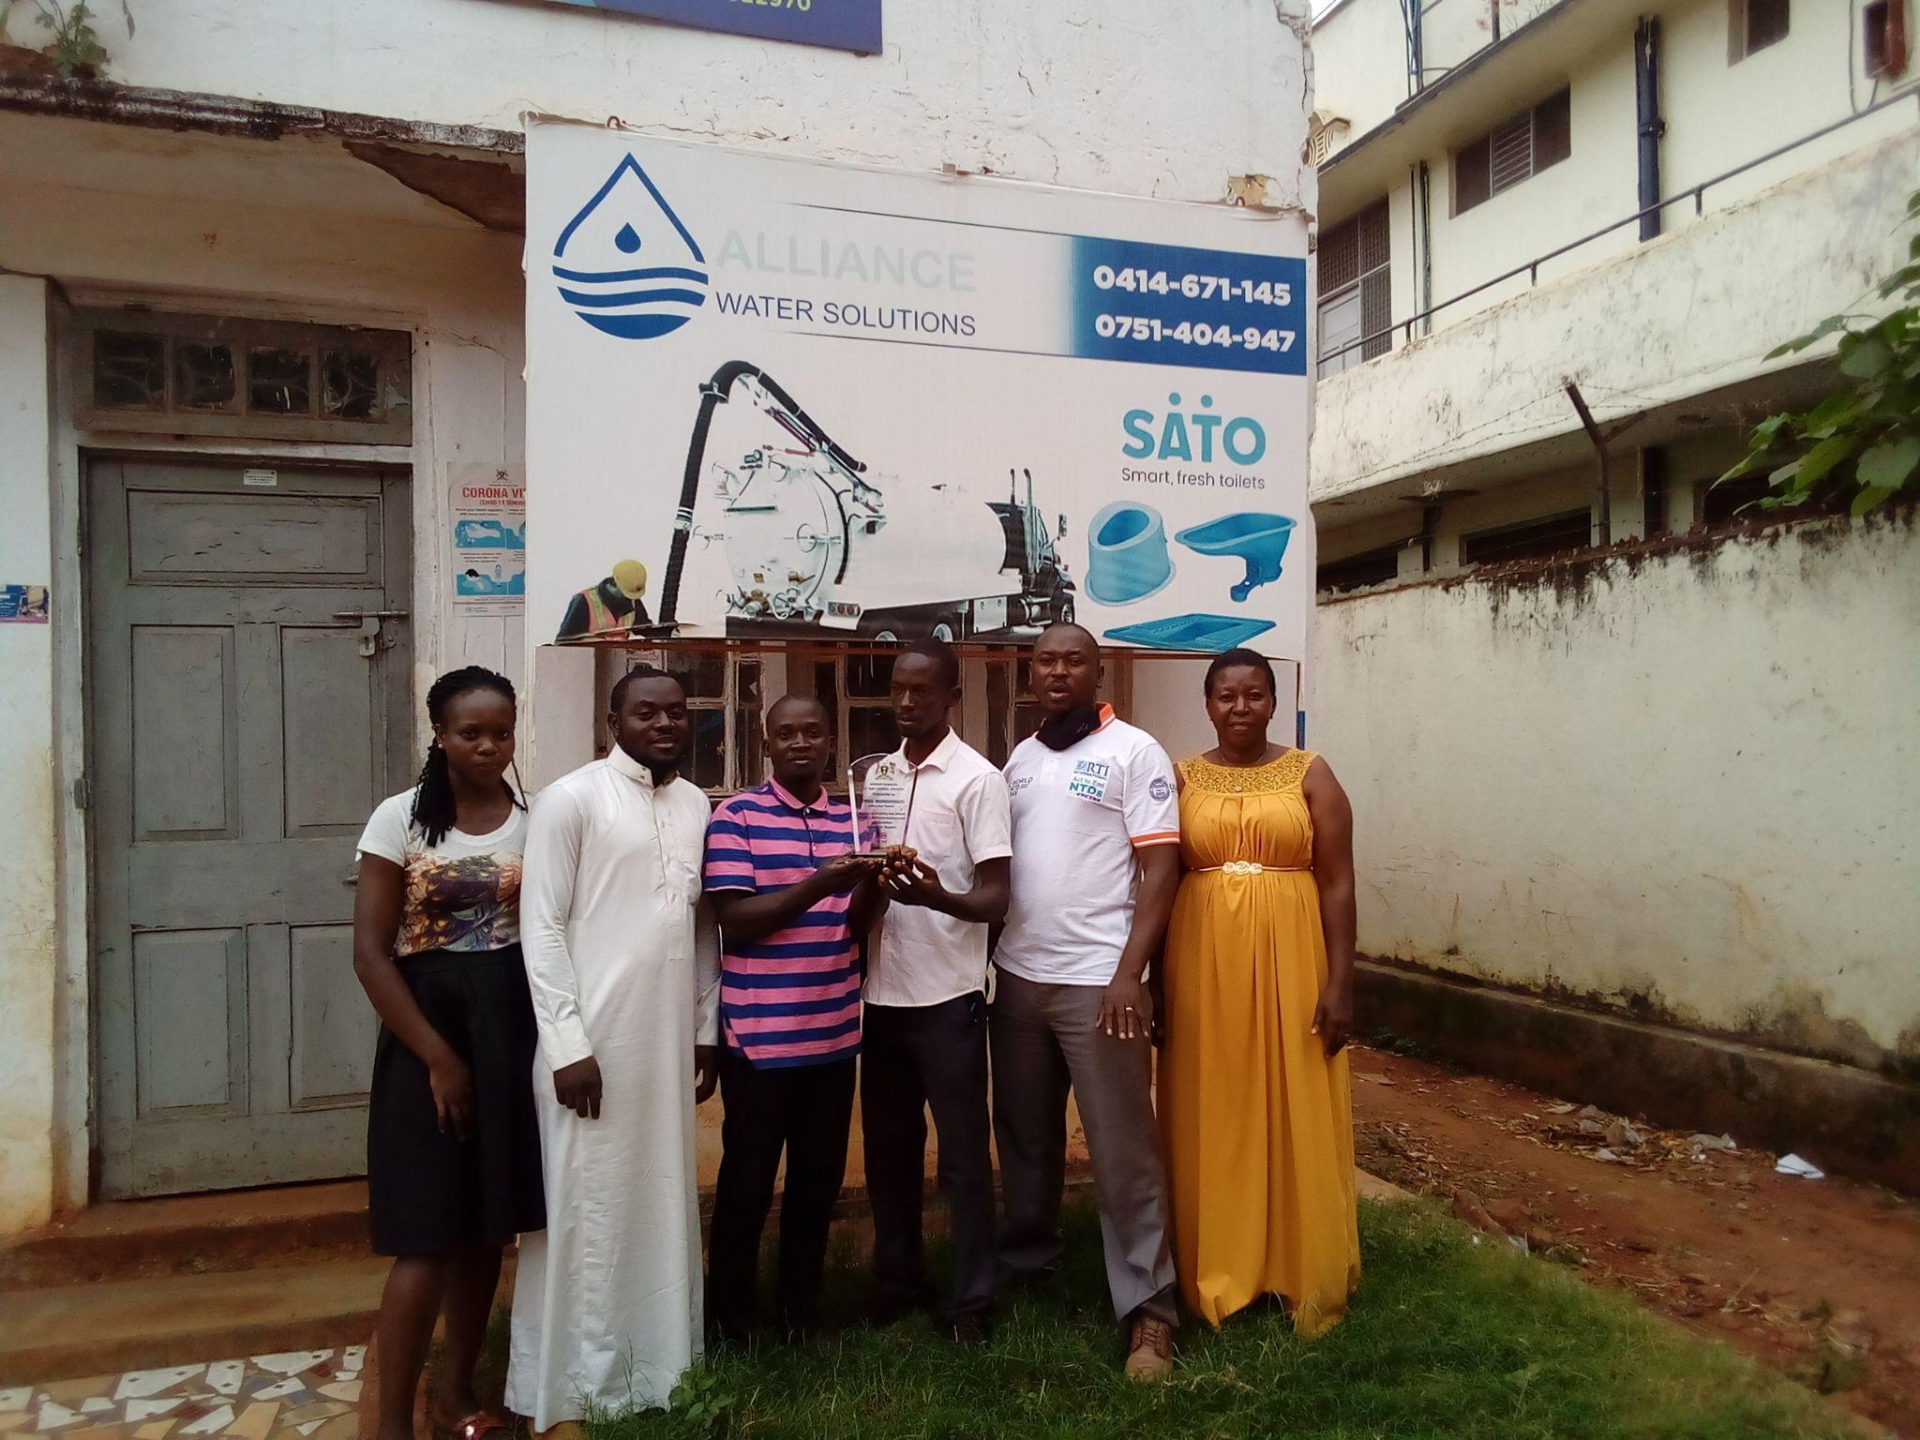
Our Goal
To promote a clean environment and increase access to safe clean water through empowering communities to own to at least 70% of the WASH interventions and sustain sanitation and water facilities at household and institution level with a focus of attaining a reduced disease free community by 2040

Slide 4
Our Focus
Waste Management (Solid and Faecal Waste)
Sanitation (improving and construction of latrines)
. Water Development (construction and rehabiliataion of water sources

Slide 5
Solid Waste Challenges
Overall, Jinja City generates 182.6 tons per day of waste of which 45% is collected
Open dumping and burning are common means of disposal
Low willingness to pay for waste management services among residents
Lack of access to bins and a belief that recycling is not important.
Limited institutional capacity and Inadequate waste management systems/infrastructure
Lack of proper tools and equipments to manage well waste
Poor data management and Revenue collection

Slide 6
Achievements Todate
The company manages solid waste in Lira and Jinja cities under a “Polluter Pay Policy” since 2020
We have 1,800 clientele that are served monthly
The company has created direct and indirect employment opportunities to 42 youths and women through; waste collection, sorting, transportation and Revenue collection
We directly manages a 2 tonnage plastic waste as a business at all times
We provide leadership to the a consortium of 12 private waste management companies in Jinja City

Slide 7
Our Ask for Solid Waste Business
Seeking $44,100 as capital investment to improve our Solid Waste Business to be allocated as follows:-
Upscaling our Plastic Business: $ 6,014 –To scale our plastic collection business from 2 tonnage to 10,000 tonnage monthly.
Building and improving Data/Revenue Management System : $2,460 -To improve data collection, Revenue collection and reporting
Tools and Equipment: $24,601 To repair, maintain and procure new tools and equipement for a Reliable and Efficient Services
4) Increasing customer base and services: $10,934. increasing our clientile base from 1,800 a month to 4,000 and initiate waste sorting at source

Slide 8
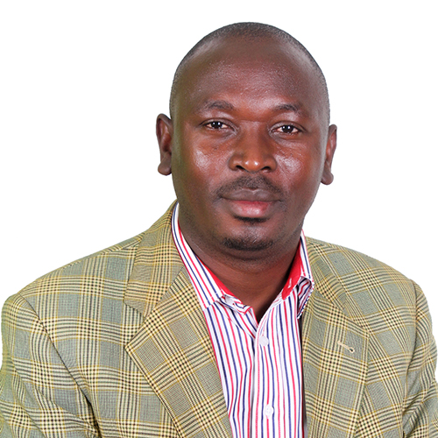
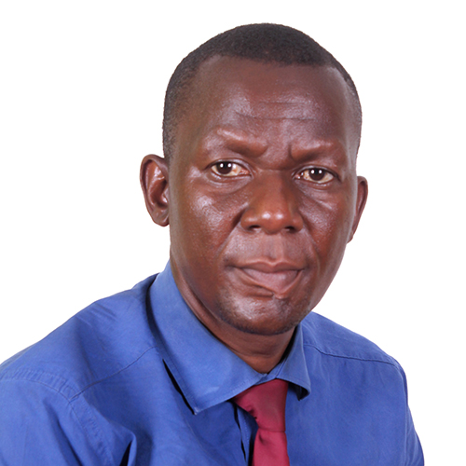
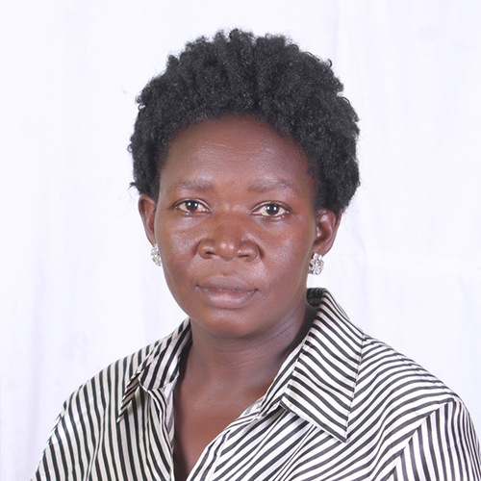
Our Team
Fred Muwanguzi CEO,
Director Walekwa Fredrick
Director. Katangula Mary

Slide 9



ALLIANCE WATER SOLUTIONS (AWASO)
Contacts
Fred Muwanguzi
Executive Director
Email: alliancewatersolutions@gmail.com
Tel: +256-414 671 145
+256-751 404 947
+256-782 522 970 (Whatsap)
https://twitter.com/alliancewaters2
https://www.facebook.com/alliancewatersolutions
www.alliancewatersolutions.org

